Slide 1
The Next Wave
of Mobility
Peggy Smith, SCRP, SGMS-T
President and CEO

Slide 2
Industrial Economy to the Connection Economy
Values more, better, faster
Builds on who you know, what you know and how that knowledge influences your connections

Slide 3
Uncertain
Economic Growth
82%
Over-
regulation
80%
Skills Shortages
77%
CEOs: TOP Threats to Global Business
Geopolitical Uncertainty
74%
Speed of
Technological Change
70%
Source: PwC 20th Annual CEO Survey

Slide 4
“Employability depends less on what you already know and more on how well you can learn, apply and adapt.” Mara Swan, EVP Global Strategy and Talent, ManpowerGroup
Globally, employers report the HIGHEST TALENT SHORTAGE since 2007
40%
41%
31%
30%
31%
34%
34%
35%
36%
38%
40%
2006
2007
2008
2009
2010
2011
2012
2013
2014
2015
2016
2010
Source: ManpowerGroup Talent Shortage Survey

Slide 5
35%
of millennials
turned down
job offers.
WHY?

Slide 6
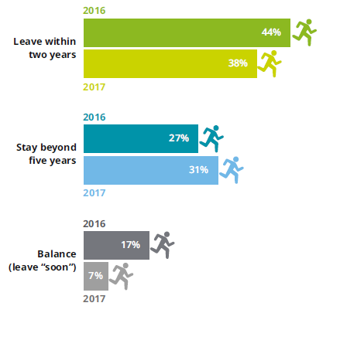
Percent of millennials who expect to…
Source: 2017 Deloitte Millennial Survey

Slide 7
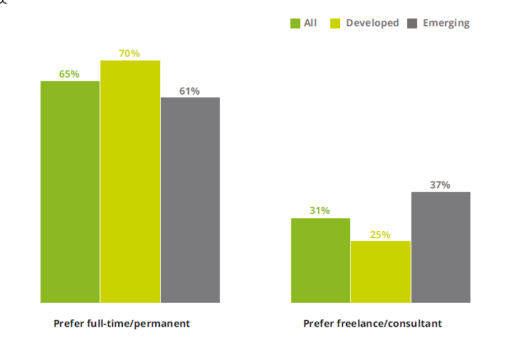
Percent of millennials who would…
Source: 2017 Deloitte Millennial Survey

Slide 8
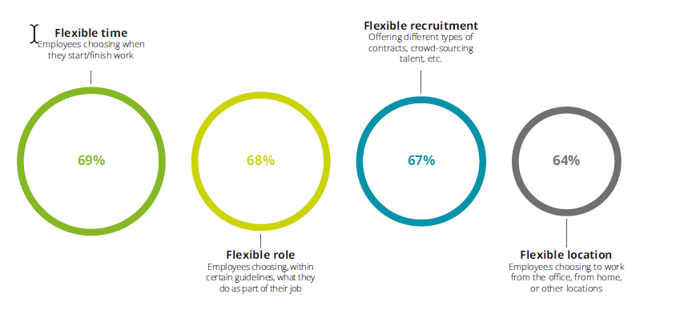
Globally, 2/3
of millennials have flexible arrangements.
Source: 2017 Deloitte Millennial Survey

Slide 10
Impact on Business Models
Impact felt already
2015-2017
2018-2020
Geopolitics
Technology/Big Data
Sharing economy
Emerging markets: demographics and middle class
Urbanization
Shifting work options
Climate change
New energy supplies and technologies
The Internet of Things
Advanced manufacturing
Aging populations
Consumer ethics, privacy
Women’s influence: economic, workforce
Robotics, autonomous transport
Artificial intelligence
Advanced materials, biotechnology
Source: WEF, Future of Jobs Report

Slide 11
The Employee Experience: The Future Of Work
“Yelpify” your employee interactions
Agile approach to recruit &
develop
employees
92%
of employers expect an increase in competition for talent this year.
Plan for a blended workforce
- Mercer , “Future-proofing HR”
Create a compelling employee experience
Develop career mobility options
Source: ManpowerGroup Employment Outlook Survey
Source: Bersin, “Predictions for 2017”

Slide 12
40-60% of U.S. workers are in declining jobs

Slide 13
A generation expands and doesn’t stay.
AI explodes.
Boomers AND millennials postpone.
Source: 2017 Gallup

Slide 15
What are companies and countries doing to combat talent shortages?
Focusing on diversity
Extending retirement age
Building university relationships
Adding on-demand workers
Expanding parental leave policies
Redesigning work

Slide 16
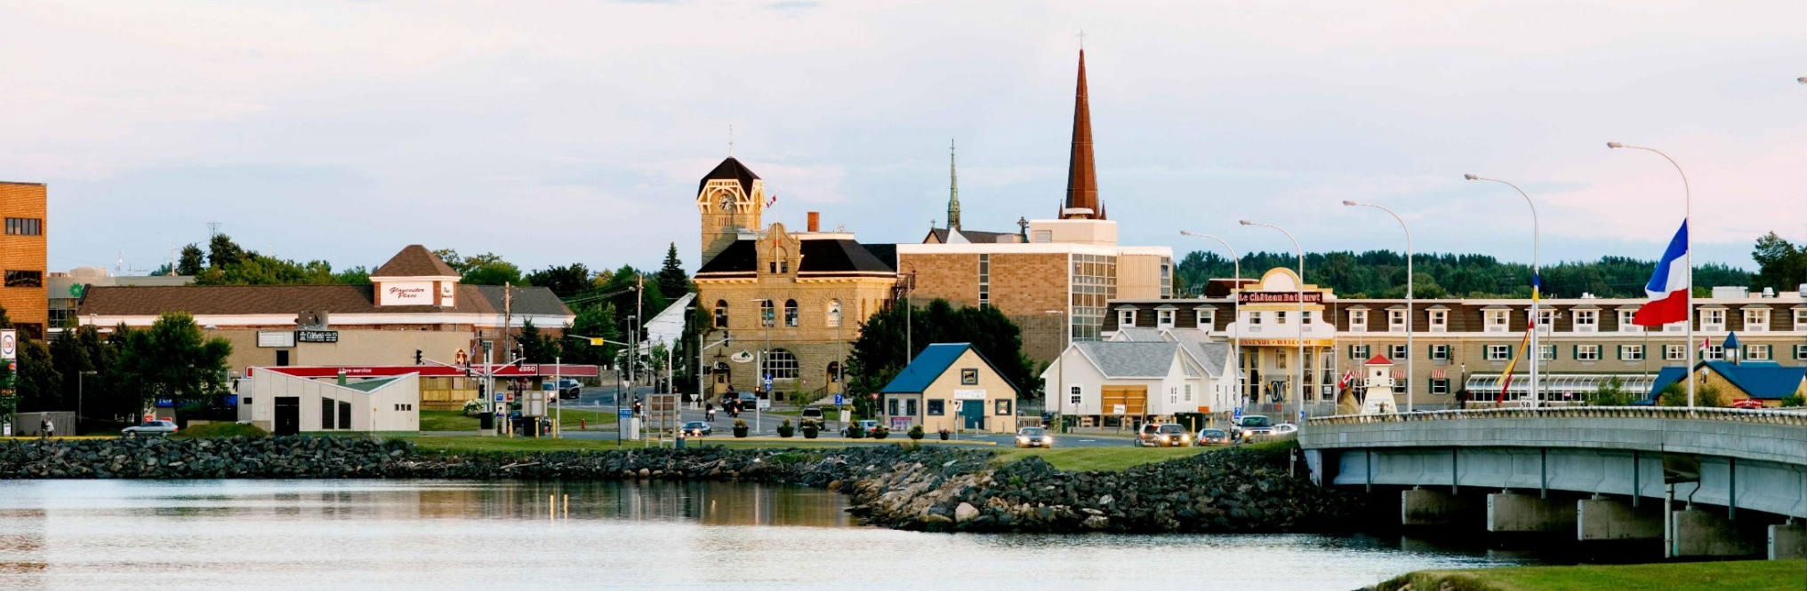
Estonia
(northern Europe)
Alaska
(United States)
New Brunswick
(Canada)

Slide 17
digital
skills
initiative
$1B
$1B

Slide 20
The Augmented Workforce
41%
of companies are making progress in cognitive and
AI technologies for their workforces

Slide 21
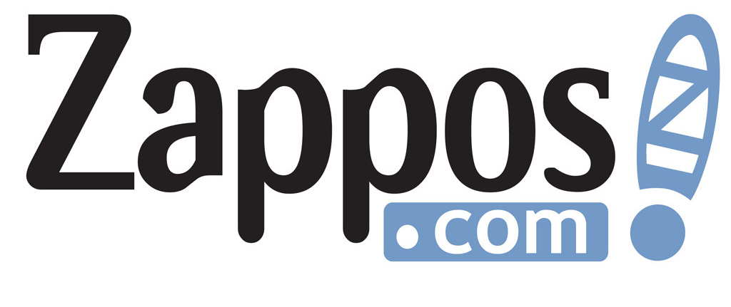

Slide 22
Q. Unpredictability?
A. Creativity!

Slide 23
Richer Recruiting Benefits
Pay student loans
1-yr. maternity leave
On-site services
Lifestyle perks
Paid time off
Volunteer service

Slide 25
And, lastly – can we change the Alexa slide to show Alexa but then around her show all the connected devices – e.g., Nest Thermostat – Harmony TV – lightbulbs – let’s drop the rock, paper, scissors…
:

Slide 26
When nobody else will volunteer to
make the beer run…

Slide 27
<Coding> as a/ second+language:}

Slide 28
Click here to subscribe…

Slide 30
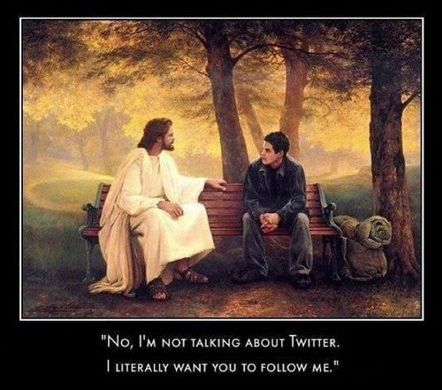
“No, I’m not talking about Twitter.
I literally want you to follow me.”

Slide 31
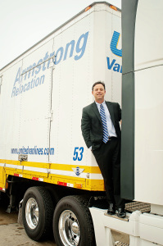
Symposium
Takeaways
TECHNOLOGY
SKILLS, SKILLS, SKILLS
THE NEW EXPAT
DUTY OF CARE
Be
Bold!
DATA
REBOOTING OUR BUSINESSES
SECURITY

Slide 32
The Next Wave
of Mobility
Peggy Smith, SCRP, SGMS-T
President and CEO

